Slide 1
Hands on Deep learning

Slide 2
Day 1 – Learning to See
- What is the deal about machine learning?
Topics to be covered:
Problem statement definition
Knowledge based algorithm
Memorization based Algorithm
Confusion matrix
Generalization importance
Bias vs Variance
Decision trees
Heuristics

Slide 3
Day 2 – Mathematical basics for Deep learning
- What does it take to start seeing the problems with deep learning’s cap?
Topics to be covered:
Linear algebra
Intro to matrices
Span of matrix
Matrix multiplication
Dot product
Calculus
Intro to calculus
Gradient of a curve
Maxima and minima
Deep learning
Types of ML
Intro to deep learning
Perceptron modelling

Slide 4
Day 3 – Hands on deep learning
- Can you find a solution for every equation with Deep learning?
Topics to be covered:
What's a neural network?
Layers of neural network
Supervised learning of Neural network(training)
Delta-rule
Gradient descent
Concept of Batch
Limitations

Slide 5
Day 4 – Hands on deep learning
- Can you find a solution for every equation with Deep learning?
Topics to be covered:
Back Propagation
The XOR problem
Cost function and learning rule
Binary classification
Multiclass classification
Improvements in neural networks
universality theorem(optional)

Slide 6
Day 5 – Deep learning playground
- How awesome is this thing?
Topics to be covered:
What are the present capabilities and future possibilities of deep learning?

Slide 7
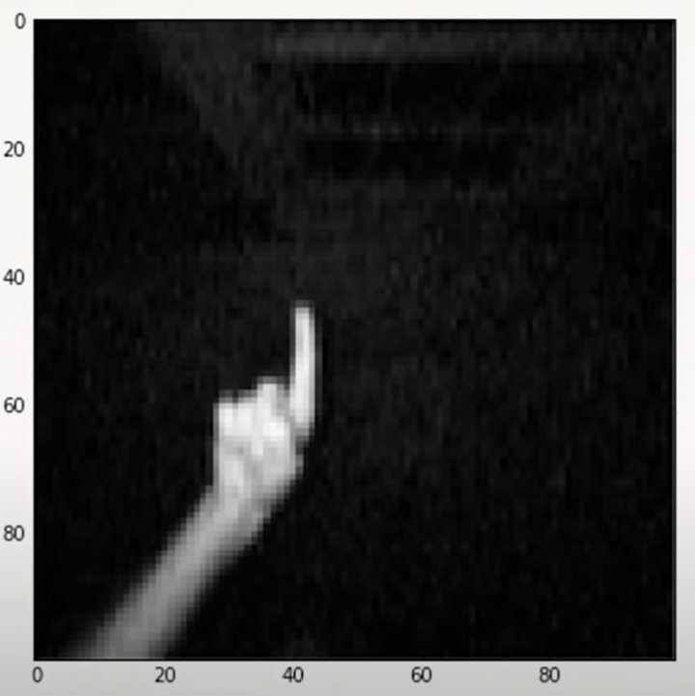
Day 1 – Learning to see
Source: Youtube – Learning to See by Welch Labs

Slide 8
Day 1 – Learning to see
15 | 14 | 52 | 167 | 190 | 156 | 43 | 4
10 | 17 | 53 | 178 | 156 | 163 | 53 | 6
18 | 16 | 73 | 185 | 196 | 162 | 50 | 5
25 | 17 | 90 | 191 | 198 | 159 | 45 | 6
20 | 12 | 55 | 166 | 175 | 200 | 49 | 10
10 | 29 | 56 | 145 | 150 | 178 | 49 | 31
15 | 99 | 79 | 156 | 144 | 159 | 82 | 16
10 | 96 | 78 | 196 | 200 | 213 | 69 | 25
Move to notebook
Source: Youtube – Learning to See by Welch Labs

Slide 9
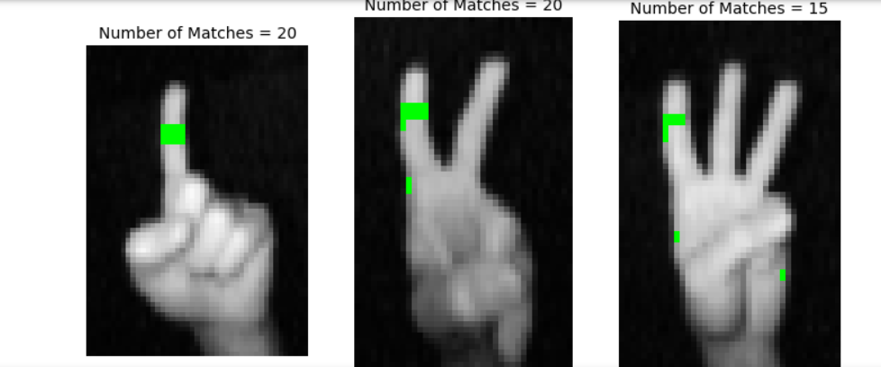
Mistakes by our rules
We didn’t identify all finger labels
We also misclassified sone non fingers as fingers
Source: Youtube – Learning to See by Welch Labs

Slide 10
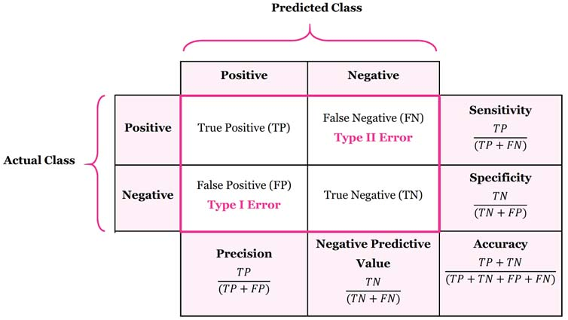
Confusion matrix
Source: Youtube – Learning to See by Welch Labs

Slide 11
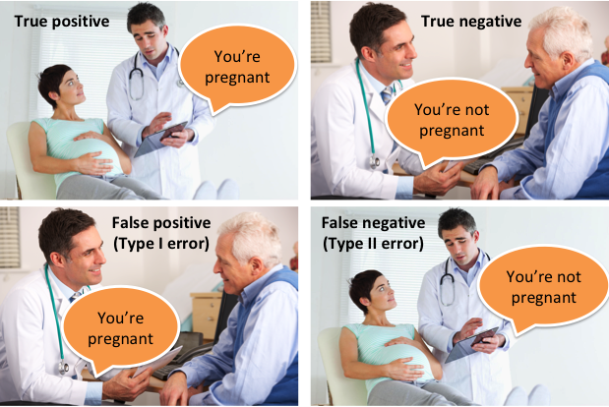
Confusion matrix
Back to notebook

Slide 12
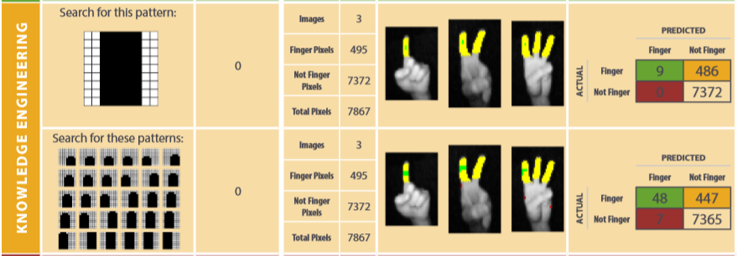
Output of 1st method and 2nd method
Source: Youtube – Learning to See by Welch Labs

Slide 13
What do we do?
Try something else?
Try more rules like rotation and stuff
Source: Youtube – Learning to See by Welch Labs

Slide 14
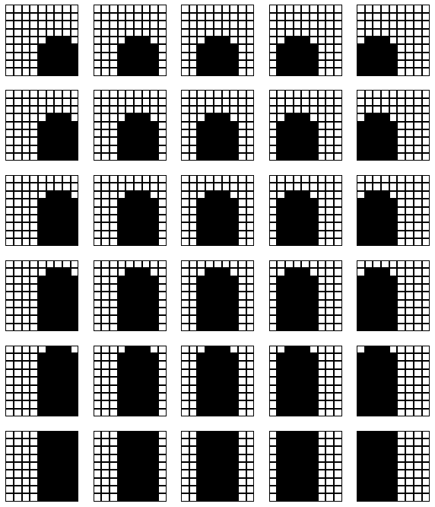
Let’s Discuss!
Source: Youtube – Learning to See by Welch Labs

Slide 15

Let’s think!
We must rewrite every rule
Complex set of rules are ridiculously hard to maintain and update for every scenario
Rewrites aren’t just feasible
Source: Youtube – Learning to See by Welch Labs

Slide 16
Let’s think!
Hard problems | Easy problems
Proving math theorems | Recognizing a face
Diagnosing problems in nuclear reactors | Walking across a room
Space shuttle mission control | Counting fingers in an image
Detecting submarines using sonar | Driving a car
Source: Youtube – Learning to See by Welch Labs

Slide 17
Let’s think!
Expert system knowledge | All humans
Proving math theorems | Recognizing a face
Diagnosing problems in nuclear reactors | Walking across a room
Space shuttle mission control | Counting fingers in an image
Detecting submarines using sonar | Driving a car
Source: Youtube – Learning to See by Welch Labs

Slide 18
Let’s think!
Easy problems | Hard problems
Proving math theorems | Recognizing a face
Diagnosing problems in nuclear reactors | Walking across a room
Space shuttle mission control | Counting fingers in an image
Detecting submarines using sonar | Driving a car
MORAVEC’S PARADOX
Source: Youtube – Learning to See by Welch Labs

Slide 19
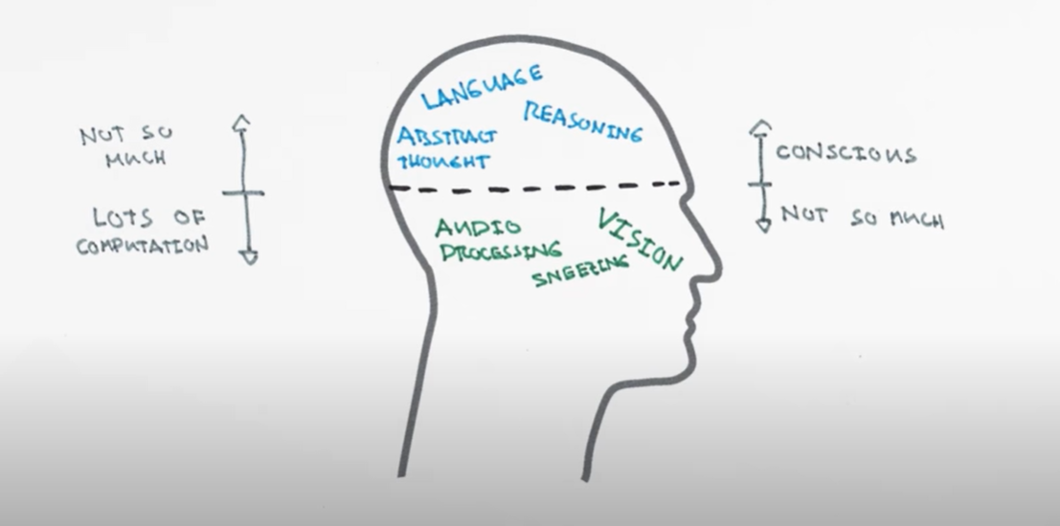
Let’s think!
Source: Youtube – Learning to See by Welch Labs

Slide 20
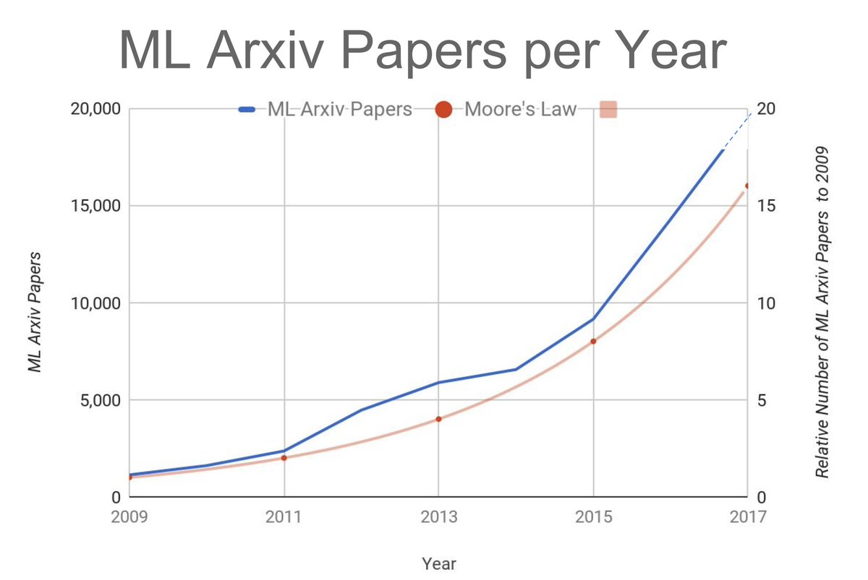
The other way to find solution
Move to notebook
Source: Youtube – Learning to See by Welch Labs

Slide 21
1st ML algorithm
Confusion matrix A
Confusion matrix B
>
Source: Youtube – Learning to See by Welch Labs

Slide 22
Performance matrix
Knowledge engineering
48 | 447
7 | 7365
Accuracy = ?
/recall
Source: Youtube – Learning to See by Welch Labs

Slide 23
Performance matrix
Baseline: with all pixels as non fingers
0 | 495
0 | 7372
Accuracy = ?
/recall
Source: Youtube – Learning to See by Welch Labs

Slide 24
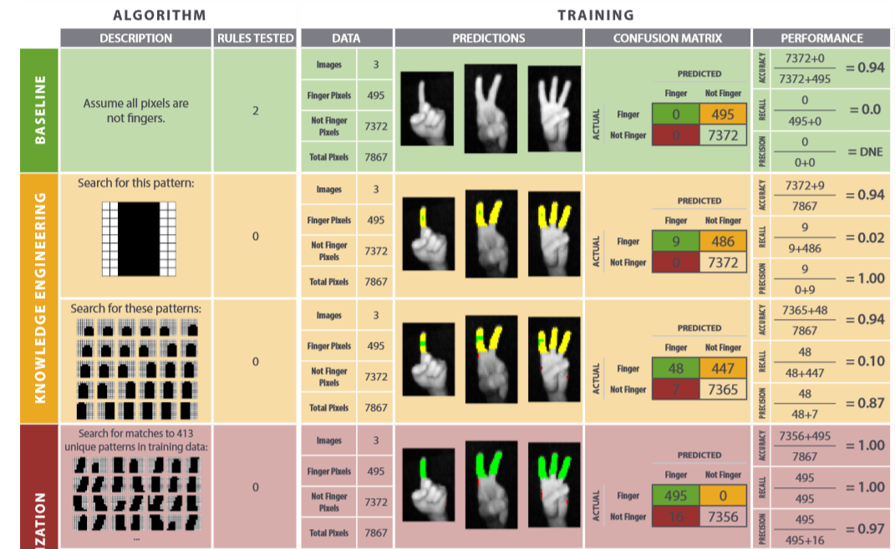
Performance matrix
memorization
Move to notebook
Source: Youtube – Learning to See by Welch Labs

Slide 25
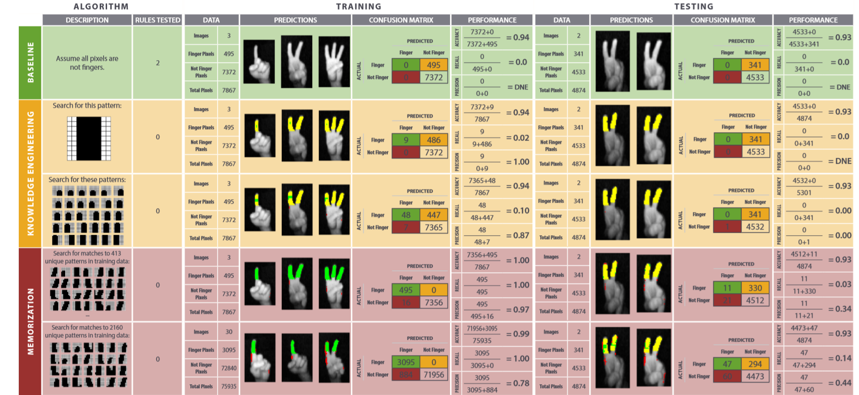
Performance matrix
Move to notebook
Source: Youtube – Learning to See by Welch Labs

Slide 26
TO LEARN IS TO GENERALISE
Move to notebook
Move to notebook
Source: Youtube – Learning to See by Welch Labs

Slide 27
New questions
How can we learn to generalize?
How can we find the solution when we have seen only a tiny bit of all possible combinations?
To answer this let’s simplify the problem with a 2x2 grid instead 9x9 grid
Source: Youtube – Learning to See by Welch Labs

Slide 28
Lets simply!!
X₁
X₂
Positive
class
X₃
X₄
Training
class
Negative
class
Testing
class
Source: Youtube – Learning to See by Welch Labs

Slide 29
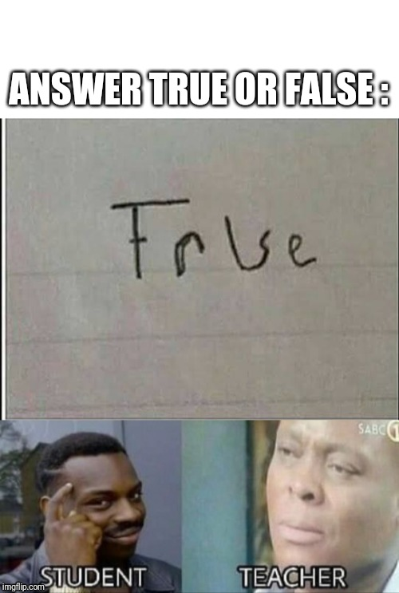
Ofc, Lets simply!!
Positive
class
Training
class
Negative
class
Positive class => X1 = 1
negative class =>( X1+X2+X3+X4) <2
Testing
class
Source: Youtube – Learning to See by Welch Labs

Slide 30
Ofc, Lets simply!!
Positive
class
HOW DO WE IDENTIFY WHICH IS CORRECT??
Training
class
Negative
class
Positive class => X1 = 1
negative class =>( X1+X2+X3+X4) <2
Testing
class
Source: Youtube – Learning to See by Welch Labs

Slide 31
Ofc, Lets simply!!
Positive
class
WAIT…
Do we even understand the actual big picture??
Training
class
Negative
class
Positive class => X1 = 1
negative class =>( X1+X2+X3+X4) <2
Testing
class
Source: Youtube – Learning to See by Welch Labs

Slide 32
Ofc, Lets simply!!
Positive
class
Are these 2 only solutions that exists? If not how many?
This is worth thinking
Training
class
Negative
class
Positive class => X1 = 1
negative class =>( X1+X2+X3+X4) <2
Testing
class
Move to excel
Source: Youtube – Learning to See by Welch Labs

Slide 33
Ofc, Lets simply!!
Machine learning is fundamentally ill posed. With data alone cannot we cannot conclude for the solution
Positive
class
Training
class
Negative
class
Positive class => X1 = 1
negative class =>( X1+X2+X3+X4) <2
Testing
class
Move to excel
Source: Youtube – Learning to See by Welch Labs

Slide 34
Machine learning is fundamentally ill posed
Assumptions are the way forward.
This theory is called futility of Bias-free learning
Source: Youtube – Learning to See by Welch Labs

Slide 35
TO LEARN IS TO GENERALISE
Move to notebook
Move to notebook
Source: Youtube – Learning to See by Welch Labs

Slide 36
Keys for human learning
Not getting always right
Assuming we can ignore stuff
Source: Youtube – Learning to See by Welch Labs

Slide 37
First assumption
We only consider 1 of the 4 inputs to make rules. That means we don’t even care what other inputs contain
X₁
X₂
Positive
class
X₃
X₄
Training
class
Negative
class
Move to excel
Source: Youtube – Learning to See by Welch Labs

Slide 38
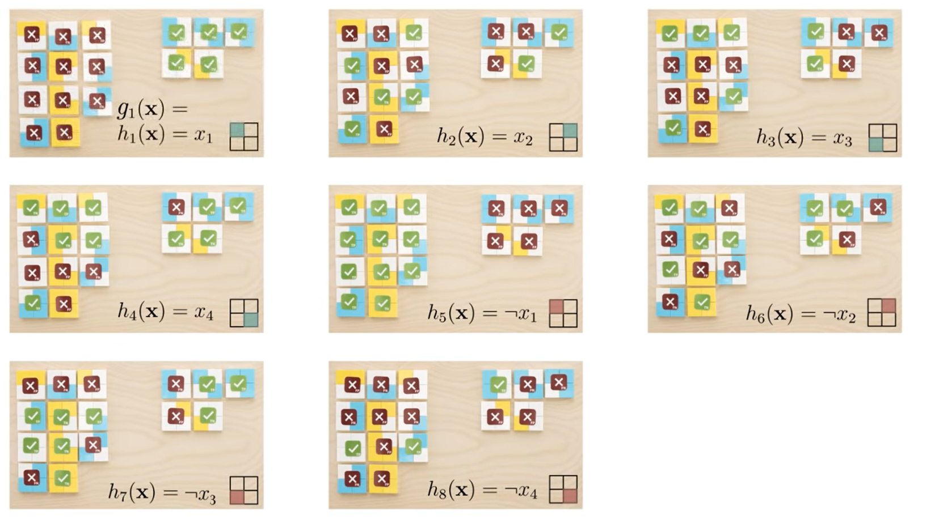
Move to excel
Source: Youtube – Learning to See by Welch Labs

Slide 39
P=0.0002
P=0.0002
P=0.0002
+
+
P=0.0002
P=0.0002
P=0.0002
+
+
P=0.0002
P=0.0002
P=0.0016
+
=
Move to excel
Source: Youtube – Learning to See by Welch Labs

Slide 40
This basically says that we have g1 which performs well on only training data and bad on randomly sampled data with a probability of 0.0016 and the g4 performing well only on training data and bad on randomly sampled data is greater than one. That means this will surely fail on randomly sampled data which will include test data too
Rules | Probability | Number of rules tested
G1 | P = 0.0002*8 = 0.0016 | 8
G4 | P = 0.0002*65536 > 1 | 65536
Source: Youtube – Learning to See by Welch Labs

Slide 41
This basically says that we have g1 which performs well on only training data and bad on randomly sampled data with a probability of 0.0016 and the g4 performing well only on training data and bad on randomly sampled data is greater than one. That means this will surely fail on randomly sampled data which will include test data too
Rules | Probability | Number of rules tested
G1 | P = 0.0002*8 = 0.0016 | 8
G4 | P = 0.0002*65536 > 1 | 65536
TOO SIMPLE
TOO COMPLEX
HENCE G1 WILL GENERALISE BETTER AND THIS WAS ACHIVED IN A HUMAN WAY OF THINKING BY IGNORING STUFF
Source: Youtube – Learning to See by Welch Labs

Slide 42
Summary
Right rules are simple
Fewer rules to test
More likely to generalize
Our solution
Simple equation
complex equation
Source: Youtube – Learning to See by Welch Labs

Slide 43
GENERALISATION
Move to notebook
Source: Youtube – Learning to See by Welch Labs

Slide 44
So what do we need now?
An algorithm that must perform well on training data and generalize.
Our solution
Simple equation
Better generalization
complex equation
Better fit for training data
Source: Youtube – Learning to See by Welch Labs

Slide 45
So what do we need now?
An algorithm that must perform well on training data and generalize.
Our solution
High BIAS
Underfitting
overfitting
High VARIANCE
Move to notebook
Source: Youtube – Learning to See by Welch Labs

Slide 46
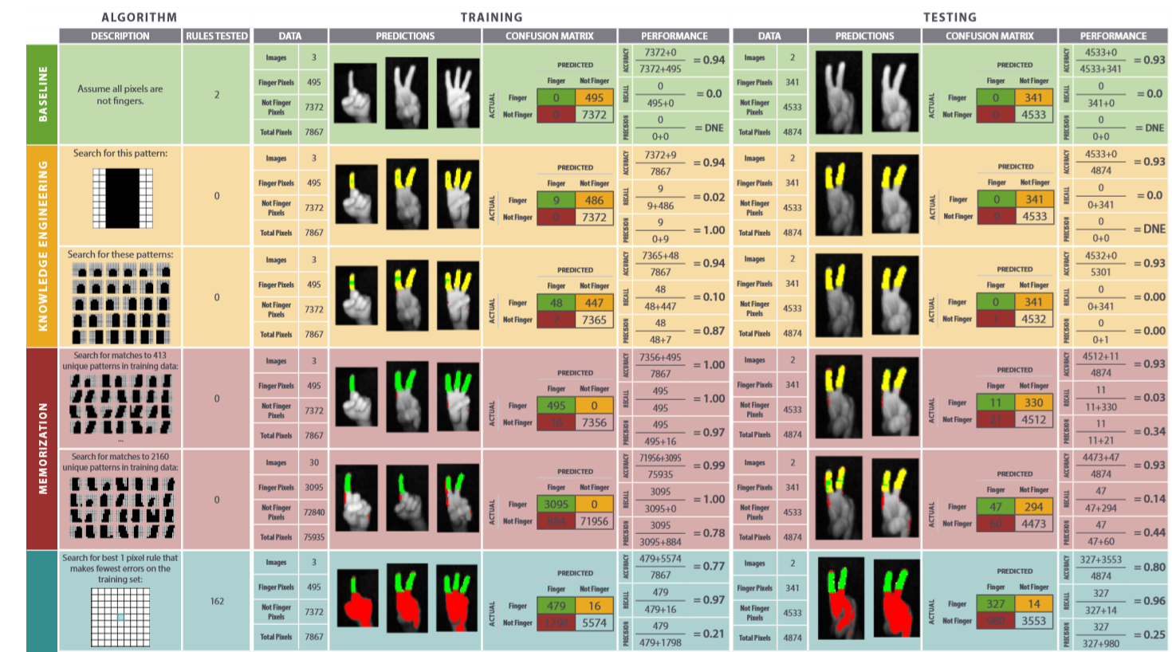
Move to notebook
Move to notebook
Source: Youtube – Learning to See by Welch Labs

Slide 47
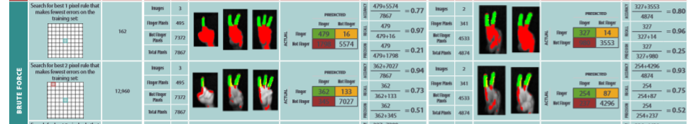
Will it generalize?
Move to notebook
Move to notebook
Source: Youtube – Learning to See by Welch Labs

Slide 48
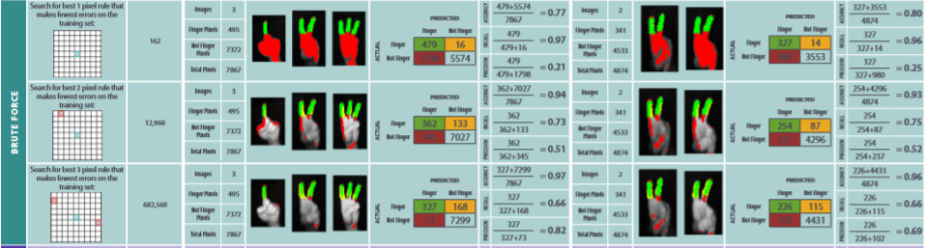
Will it generalize?
Move to notebook
Source: Youtube – Learning to See by Welch Labs

Slide 49
Let's check the trend
Pixels in rule | Run time | Rules tested
1 | 0.02 | 162
2 | 4.488 | 12960
3 | 160.621 | 682560
4 | 2541 | 26619840
Move to excel
Source: Youtube – Learning to See by Welch Labs

Slide 50
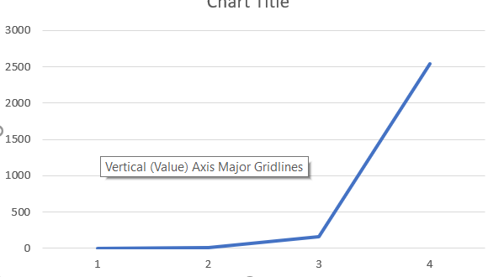
Let's check the trend
Pixels in rule | Run time | Rules tested
1 | 0.02 | 162
2 | 4.488 | 12960
3 | 160.621 | 682560
4 | 2541 | 26619840
This failure to scale is called intractability. And this contributed to the first AI winter 1974-1980
Source: Youtube – Learning to See by Welch Labs

Slide 51
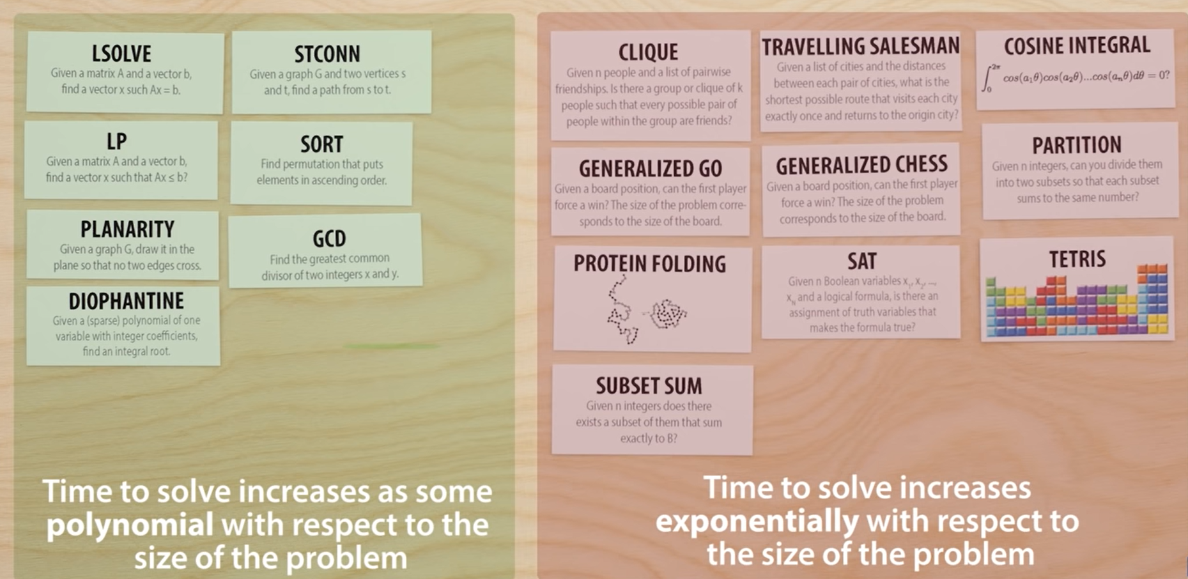
To understand the issue we need another to know a million-dollar question
Source: Youtube – Learning to See by Welch Labs

Slide 52
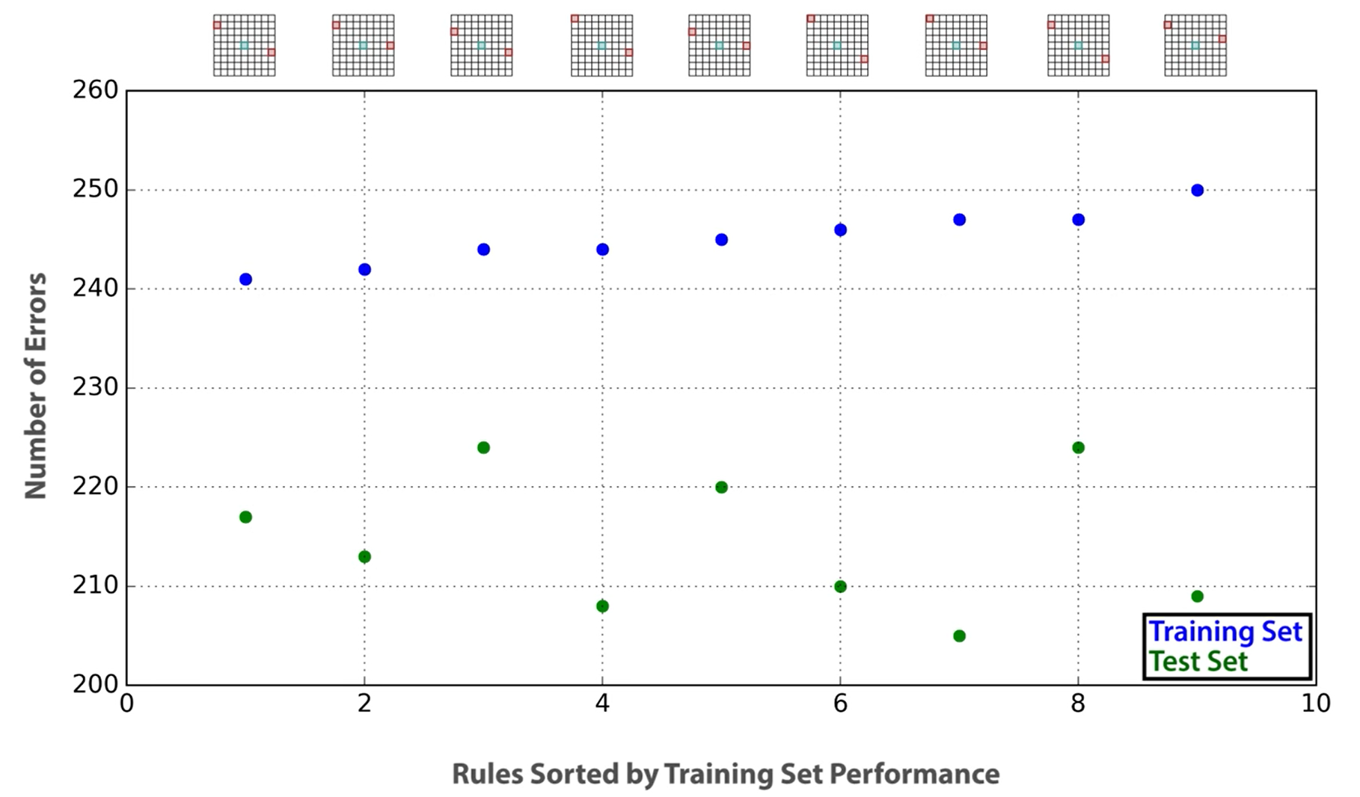
Let’s see the what the issue is?
Source: Youtube – Learning to See by Welch Labs

Slide 53
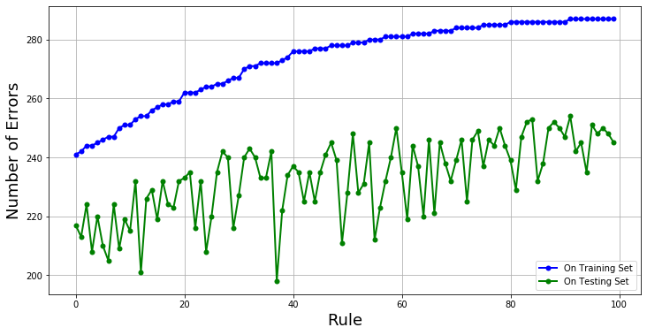
Let’s see the what the issue is?
Source: Youtube – Learning to See by Welch Labs

Slide 54
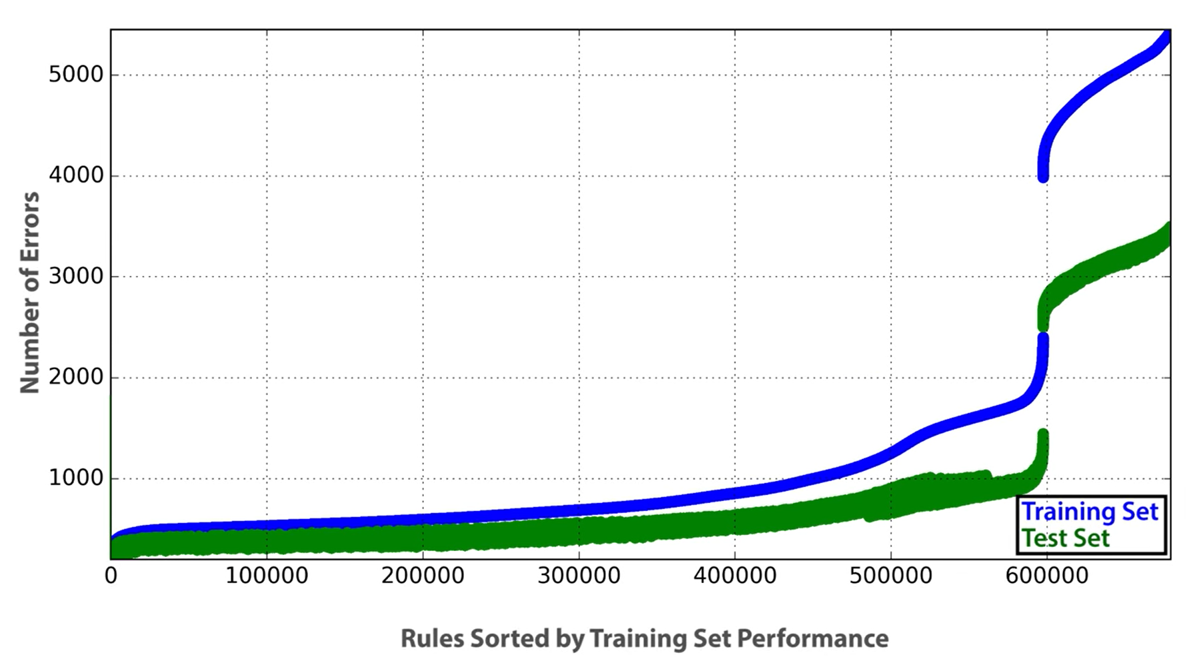
Let’s see the what the issue is?
Source: Youtube – Learning to See by Welch Labs

Slide 55
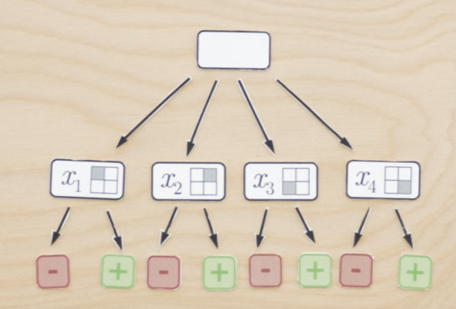
Drawing a tree
Source: Youtube – Learning to See by Welch Labs

Slide 56
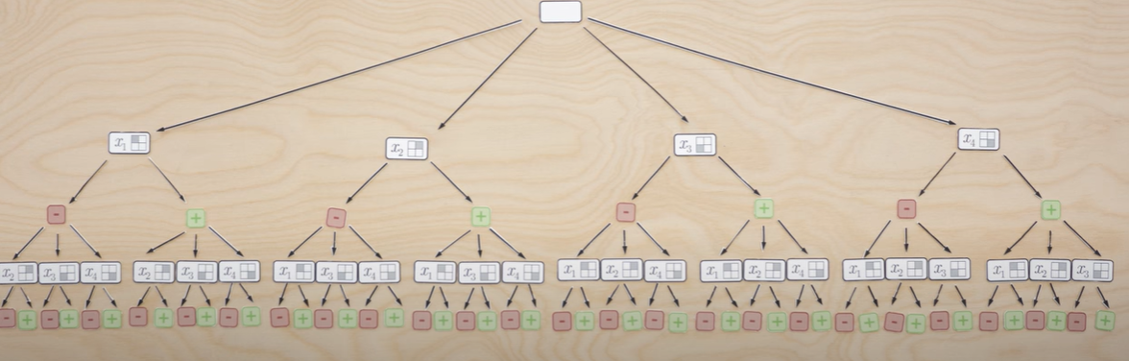
Drawing a tree
Source: Youtube – Learning to See by Welch Labs

Slide 57
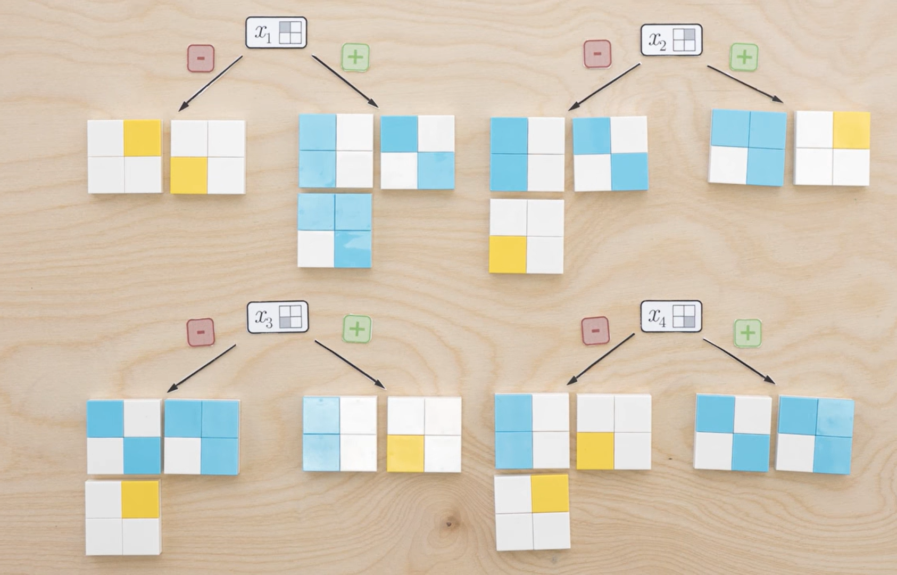
Splitting by one pixel
Source: Youtube – Learning to See by Welch Labs

Slide 58
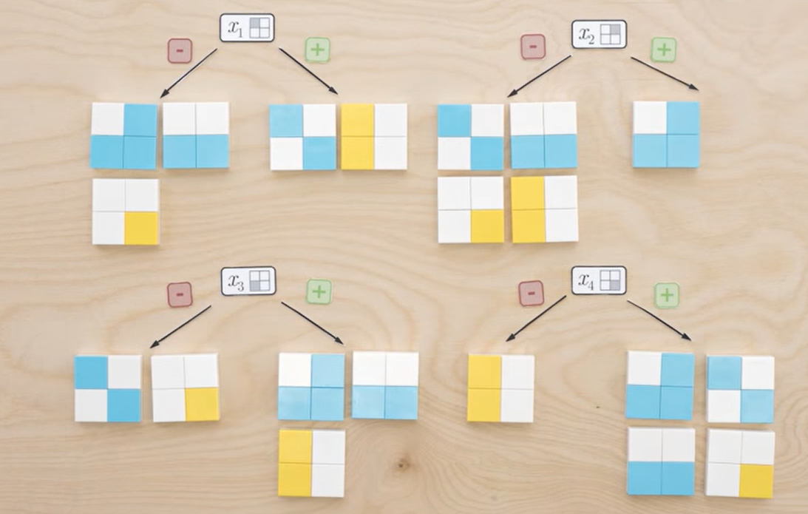
How about this example
Source: Youtube – Learning to See by Welch Labs

Slide 59
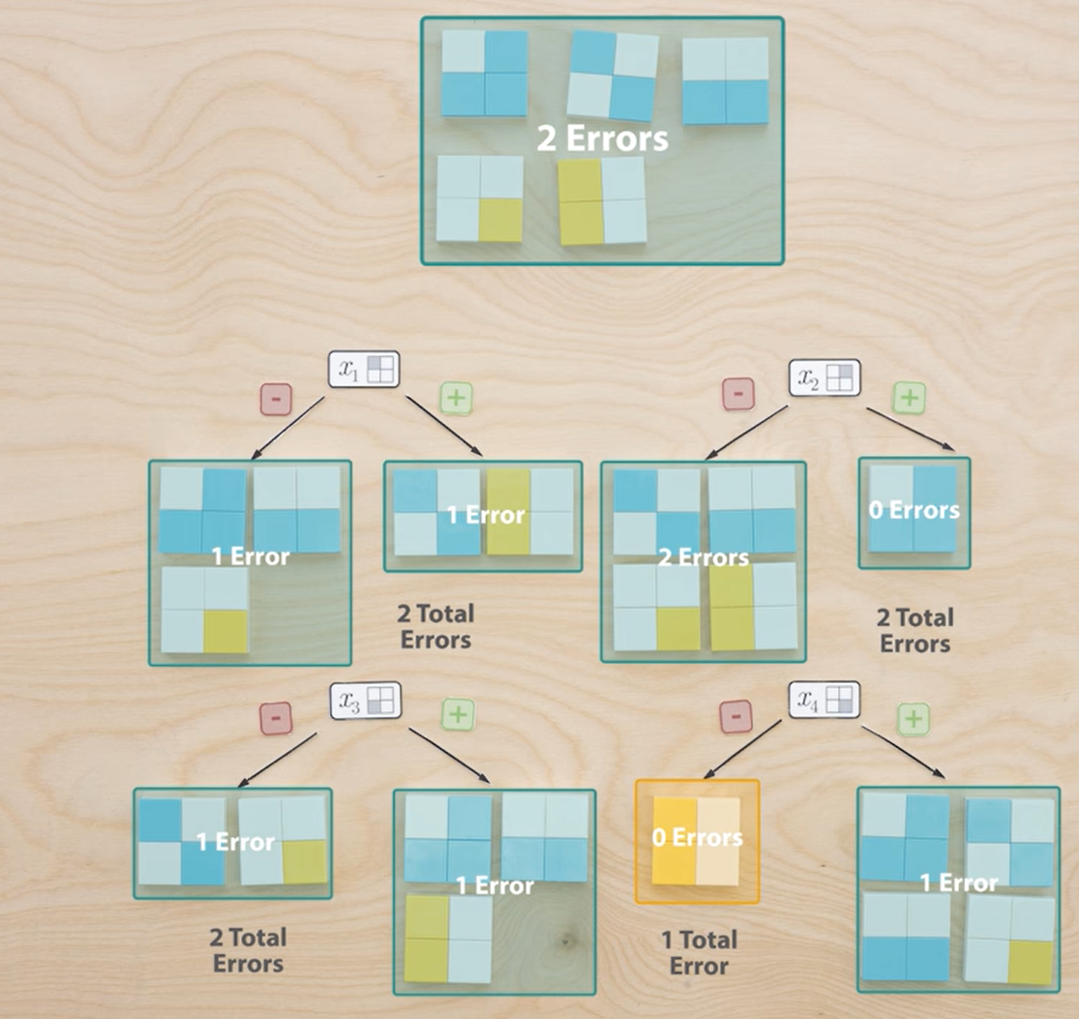
Source: Youtube – Learning to See by Welch Labs

Slide 60
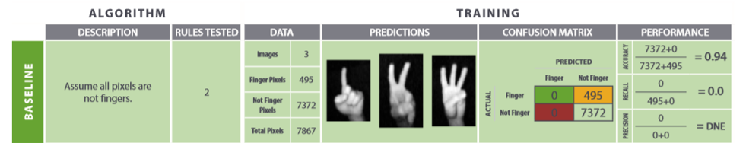
Now back to finger counting problem
Source: Youtube – Learning to See by Welch Labs

Slide 61
Now back to finger counting problem
x0
 |  |  |  | x40
Source: Youtube – Learning to See by Welch Labs

Slide 62
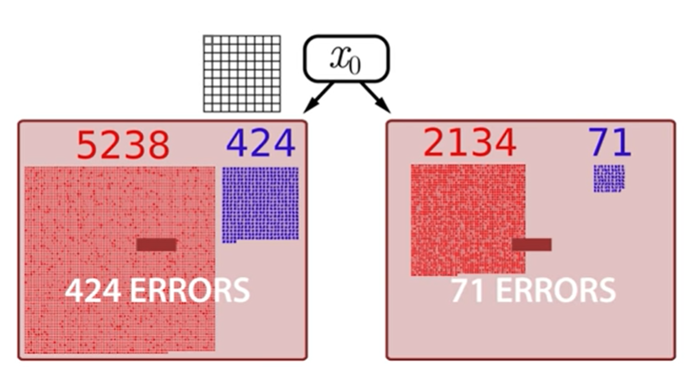
Now back to finger counting problem
Source: Youtube – Learning to See by Welch Labs

Slide 63
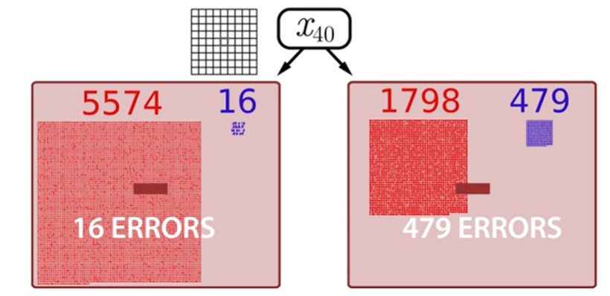
Now back to finger counting problem
Total errors=?
Source: Youtube – Learning to See by Welch Labs

Slide 64
Now back to finger counting problem
495 | 495 | 495
 |  | 495 | 494 | 495 | 495
Total errors=?
Source: Youtube – Learning to See by Welch Labs

Slide 65
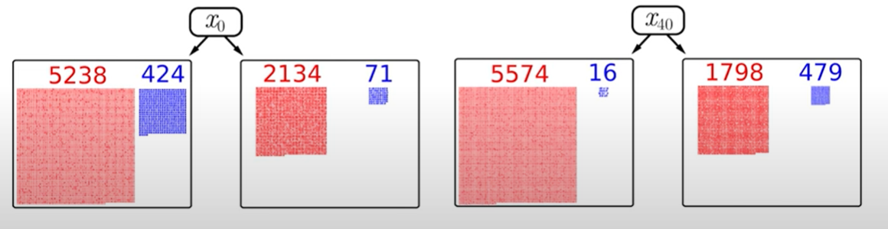
Now back to finger counting problem
Source: Youtube – Learning to See by Welch Labs

Slide 66
Back to toy data
Source: Youtube – Learning to See by Welch Labs

Slide 67
Back to toy data
impurity
Fraction of +ve example of the total example
Source: Youtube – Learning to See by Welch Labs

Slide 68
Back to toy data
Source: Youtube – Learning to See by Welch Labs

Slide 69
Heuristics
Why does it always remain same and equal to base line?
i.e.,
I(p₀) = α*I(p_{l}) + (1- α)*I(p_{r})=?
P₀ = α*p_{l}+ (1- α) p_{r}
Therefore impurity before split I(p₀) =I(α*p_{l}+ (1- α) p_{r})
And since we designed a linear error function
I(α*p_{l}+ (1- α) p_{r}) = α*I(p_{l}) + (1- α)*I(p_{r})
Source: Youtube – Learning to See by Welch Labs

Slide 70
Heuristics
Finally we found the missing link
Source: Youtube – Learning to See by Welch Labs

Slide 71
Heuristics
Finally we found the missing link
I(α*p_{l}+ (1- α) p_{r}) >= α*I(p_{l}) + (1- α)*I(p_{r})
Source: Youtube – Learning to See by Welch Labs

Slide 72
Heuristics
impurity
Fraction of +ve example of the total example
Source: Youtube – Learning to See by Welch Labs

Slide 73
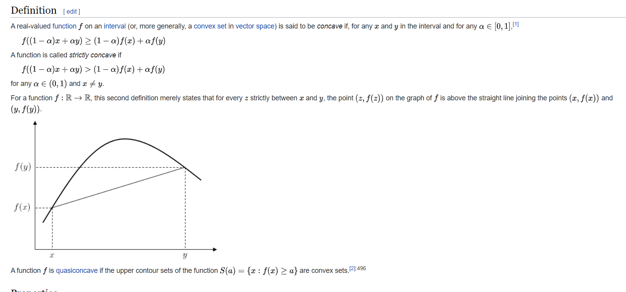
Concave functions
Source: Youtube – Learning to See by Welch Labs, wikipedia

Slide 74
Back to toy data with entropy
E(B, Y) = P(B) * P(1/B) + P(Y) * P(1/Y)
Source: Youtube – Learning to See by Welch Labs

Slide 75
Heuristics rule
Move to notebook
Source: Youtube – Learning to See by Welch Labs, wikipedia

Slide 76
Basics of Calculus
Slope, Maxima and minima concepts

Slide 77
Why Deep learning/Machine Learning?
This is something that has fooled of brilliant scientists with its apparent simplicity with practical complexity
Now we will try to understand how a machine learns to see and we will establish a clear idea why deep learning is required.
For example: We will count the number of fingers in the image with Machine Learning
Moravec’s Paradox
Confusion matrix
Precision, recall, accuracy
To learn is to generalize
How can we learn rules that will actually generalize?
How can we learn when we have only seen a veerryyy verrry small portion of all possible examples?
Source: Youtube – Learning to See by Welch Labs

Slide 78
Linear algebra for Deep learning
Span of matrix
Matrix multiplication
Dot product

Slide 79
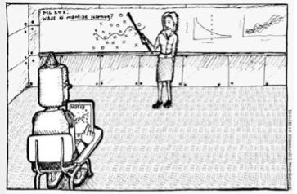
Introduction to Machine learning
Machine Learning is a modeling technique that involves data
“Deep Learning is a kind of Machine Learning, and Machine Learning is a kind of Artificial Intelligence.”
Source: Matlab Deep learning – Phil Kim

Slide 80
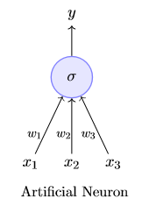
Intro to Deep learning
The most fundamental unit of a deep neural network is called an artiﬁcial neuron
Source: IIT-Rohar- Deep learning- Part 1

Slide 81
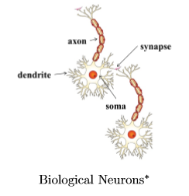
Intro to Deep learning
The most fundamental unit of a deep neural network is called an artiﬁcial neuron
copied
dendrite: receives signals from other neurons
synapse: point of connection to other neurons
soma: processes the information
axon: transmits the output of this neuron
Source: IIT-Rohar- Deep learning- Part 1

Slide 82

Intro to Deep learning
The most fundamental unit of a deep neural network is called an artiﬁcial neuron
Inspired
dendrite: receives signals from other neurons
synapse: point of connection to other neurons
soma: processes the information
axon: transmits the output of this neuron
Source: IIT-Rohar- Deep learning- Part 1

Slide 83
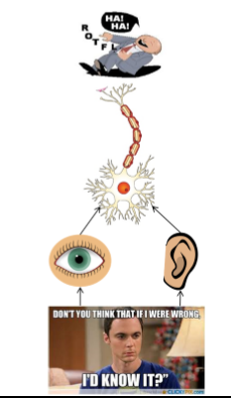
Intro to Deep learning
Let us see a very cartoonish illustration of how a neuron works
Our sense organs interact with the outside world
They relay information to the neurons
The neurons (may) get activated and produces a response (laughter in this case)
Source: IIT-Rohar- Deep learning- Part 1

Slide 84
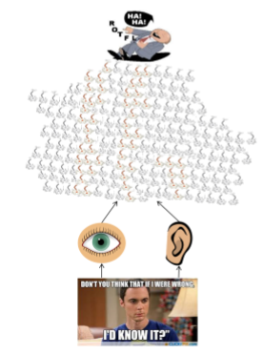
Intro to Deep learning
Let us see a very cartoonish illustration of how a neuron works
Our sense organs interact with the outside world
They relay information to the neurons
The neurons (may) get activated and produces a response (laughter in this case)
Source: IIT-Rohar- Deep learning- Part 1

Slide 85
Intro to Deep learning
Let us see a very cartoonish illustration of how a neuron works
Our sense organs interact with the outside world
They relay information to the neurons
The neurons (may) get activated and produces a response (laughter in this case)
Source: IIT-Rohar- Deep learning- Part 1

Slide 86
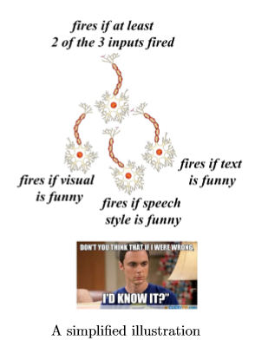
Intro to Deep learning
I understand very little about how the brain works!
What you saw so far is an overly simpliﬁed explanation of how the brain works!
But this explanation suﬃces for the purpose of this course!
Source: IIT-Rohar- Deep learning- Part 1

Slide 87
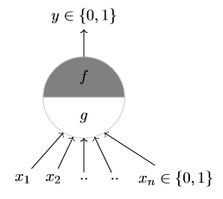
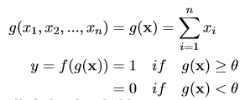
McCulloch Pitts Neuron
McCulloch (neuroscientist) and Pitts (logician) proposed a highly simpliﬁed computational model of the neuron (1943)
g aggregates the inputs and the function f takes a decision based on this aggregation
The inputs can be excitatory or inhibitory
y = 0 if any x_{i} is inhibitory, else
θ is called the thresholding parameter This is called Thresholding Logic
Source: IIT-Rohar- Deep learning- Part 1

Slide 88
McCulloch Pitts Neuron
Implementation of Boolean functions
Source: IIT-Rohar- Deep learning- Part 1

Slide 89
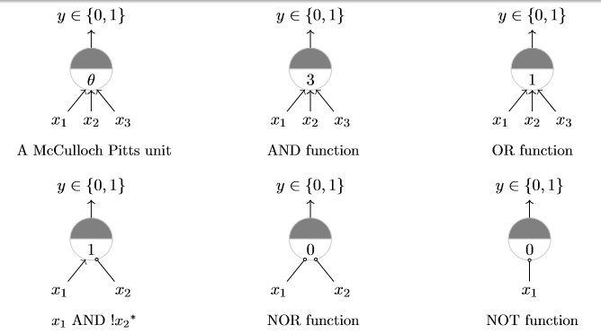
McCulloch Pitts Neuron
Implementation of Boolean functions
Source: IIT-Rohar- Deep learning- Part 1

Slide 90
McCulloch Pitts Neuron
Can we implement the XOR function??
Source: IIT-Rohar- Deep learning- Part 1

Slide 91

McCulloch Pitts Neuron
Can we implement the XOR function??
Source: IIT-Rohar- Deep learning- Part 1

Slide 92

McCulloch Pitts Neuron
Can we implement the XOR function??
Source: IIT-Rohar- Deep learning- Part 1

Slide 93
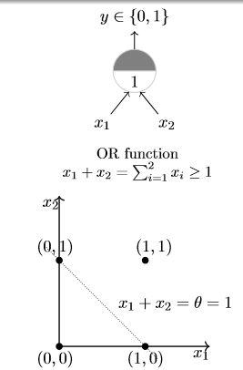
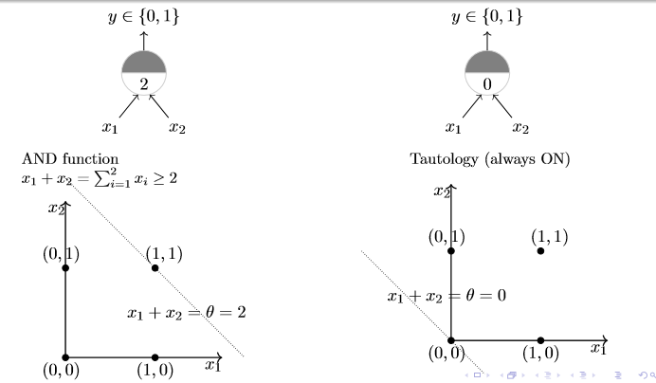
McCulloch Pitts Neuron
Implementation on x y plane
Source: IIT-Rohar- Deep learning- Part 1

Slide 94
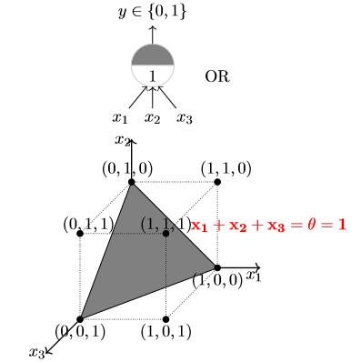
McCulloch Pitts Neuron
Implementation on x y z plane
Source: IIT-Rohar- Deep learning- Part 1

Slide 95
McCulloch Pitts Neuron
Story so far
A single McCulloch Pitts Neuron can be used to represent boolean functions which are linearly separable
Linear separability (for boolean functions) : There exists a line (plane) such that all inputs which produce a 1 lie on one side of the line (plane) and all inputs which produce a 0 lie on other side of the line (plane)
Story ahead
What about non-boolean (say, real) inputs ?
Do we always need to hand code the threshold ?
Are all inputs equal ?
What if we want to assign more weight (importance) to some inputs ?
What about functions which are not linearly separable ?
Source: IIT-Rohar- Deep learning- Part 1

Slide 96
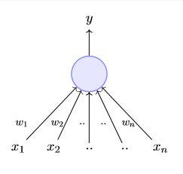
Perceptron
Frank Rosenblatt, an American psychologist, proposed the classical perceptron model (1958)
A more general computational model than McCulloch–Pitts neurons
Main diﬀerences: Introduction of numerical weights for inputs and a mechanism for learning these weights
Inputs are no longer limited to Boolean value
Source: IIT-Rohar- Deep learning- Part 1

Slide 97
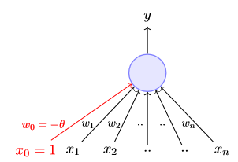
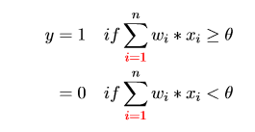
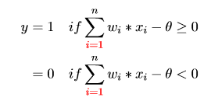
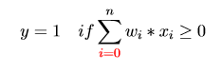
Perceptron
Frank Rosenblatt, an American psychologist, proposed the classical perceptron model (1958)
A more general computational model than McCulloch–Pitts neurons
Main diﬀerences: Introduction of numerical weights for inputs and a mechanism for learning these weights
Inputs are no longer limited to Boolean value
OR
OR
where, x₀ = 1 and w₀ = −θ
Source: IIT-Rohar- Deep learning- Part 1

Slide 98
Perceptron
We will now try to answer the following questions:
Why are we trying to implement Boolean functions?
Why do we need weights ?
Why is w0 = −θ called the bias
Source: IIT-Rohar- Deep learning- Part 1

Slide 99
Perceptron
x1 = isActorDamon
x2 = isGenreThriller
x3 = isDirectorNolan
Source: IIT-Rohar- Deep learning- Part 1

Slide 100
Perceptron
Consider the task of predicting whether we would like a movie or not
Suppose, we base our decision on 3 inputs (binary, for simplicity)
Based on our past viewing experience (data), we may give a high weight to isDirectorNolan as compared to the other inputs
Speciﬁcally, even if the actor is not Matt Damon and the genre is not thriller we would still want to cross the threshold θ by assigning a high weight to isDirectorNolan
w0 is called the bias as it represents the prior (prejudice)
A movie buﬀ may have a very low threshold and may watch any movie irrespective of the genre, actor, director [θ = 0]
On the other hand, a selective viewer may only watch thrillers starring Matt Damon and directed by Nolan [θ = 3]
The weights (w1,w2,...,wn) and the bias (w0) will depend on the data (viewer history in this case)
x1 = isActorDamon
x2 = isGenreThriller
x3 = isDirectorNolan
Source: IIT-Rohar- Deep learning- Part 1

Slide 101
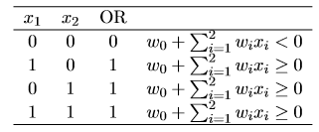
Perceptron
Implementing OR gate
Source: IIT-Rohar- Deep learning- Part 1

Slide 102
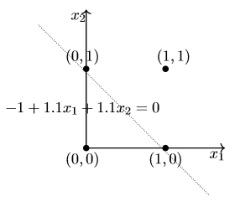
Perceptron
y
-1
1.1
1.1
1
x1
x2
Source: IIT-Rohar- Deep learning- Part 1

Slide 103
Perceptron
Error and error surface
x1
w1 | w2 | error
x2
-1 + W₁*X₁ + W₂*X₂ = Y
Source: IIT-Rohar- Deep learning- Part 1

Slide 104
Perceptron
Error and error surface
Graph to be plotted on Jupyter
Notes:
For ease of analysis, we will keep w0 ﬁxed (-1) and plot the error for different values of w1,w2
For a given w0,w1,w2 we will compute−w0+w1∗x1+w2∗x2 for all combinations of (x1,x2) and note down how many errors we make
For the OR function, an error occurs
if (x1,x2) = (0,0) but−w0+w1∗x1+ w2 ∗x2 ≥ 0 or if (x1,x2) 6= (0,0) but −w0 + w1 ∗x1 + w2 ∗x2 < 0
We are interested in ﬁnding an algorithm which ﬁnds the values of w1,w2 which minimize this error
Source: IIT-Rohar- Deep learning- Part 1

Slide 105
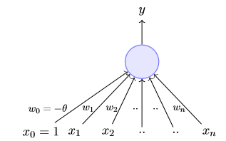
Perceptron
Perceptron Learning Algorithm
we want the perceptron to ﬁnd the equation of this separating plane (or ﬁnd the values of w0,w1,w2,..,wm)
x1 = isActorDamon
x2 = isGenreThriller
x3 = isDirectorNolan
x4 = imdbRating(scaled to 0 to 1)
... ...
xn = criticsRating(scaled to 0 to 1
Source: IIT-Rohar- Deep learning- Part 1

Slide 106
Perceptron
Perceptron Learning Algorithm
P <- inputs with label 1
N <- inputs with label 0
Source: IIT-Rohar- Deep learning- Part 1

Slide 107

Perceptron
Perceptron Learning Algorithm
x₂
x₁
Source: IIT-Rohar- Deep learning- Part 1

Slide 108
W
Source: IIT-Rohar- Deep learning- Part 1

Slide 109


W
ideal
Source: IIT-Rohar- Deep learning- Part 1

Slide 110
Perceptron
The XOR implementation
x1
x2
Source: IIT-Rohar- Deep learning- Part 1

Slide 111

Perceptron
The XOR implementation
x1 | x2 | h1 | h2 | h3 | h4 | y
-1 | -1 | 1 | 0 | 0 | 0 | 0 = w1
-1 | 1 | 0 | 1 | 0 | 0 | 1 = w2
1 | -1 | 0 | 0 | 1 | 0 | 1 = w3
1 | 1 | 0 | 0 | 0 | 1 | 0 = w4
Source: IIT-Rohar- Deep learning- Part 1

Slide 112
Enough of Boolean Function!!!
How can we represent any function??????
Source: IIT-Rohar- Deep learning- Part 1

Slide 113

BYE.. BYE… Perceptron and Hi Sigmoid neuron
x1 | y
0.51 | 1
.49 | 0
Source: IIT-Rohar- Deep learning- Part 1

Slide 114

BYE.. BYE… Perceptron and Hi Sigmoid neuron
x1 | y
0.51 | 1
.49 | 0
Source: IIT-Rohar- Deep learning- Part 1

Slide 115


BYE.. BYE… Perceptron and Hi Sigmoid neuron
There will always be this sudden change in the decision (from 0 to 1) when $\sum_{i−1}^{n}{Wi.Xi}$ crosses the threshold (-w0)
Source: IIT-Rohar- Deep learning- Part 1

Slide 116


Sigmoid neuron
Here is one form of the sigmoid function called the logistic function
Source: IIT-Rohar- Deep learning- Part 1

Slide 117


Sigmoid neuron
Source: IIT-Rohar- Deep learning- Part 1

Slide 118

Sigmoid neuron
Earlier we mentioned that a single perceptron cannot deal with this data because it is not linearly separable
There are 3 misclassifications in each color.
But the line doesn’t seem too bad
Still we can live with that line as most real world applications will have noise and there will surely some error
So having the Error to 0 like the last time is impossible in real world applications
So what could be the error here?
Source: IIT-Rohar- Deep learning- Part 1

Slide 119



Supervised learning of Sigmoid neuron
Data : {x_{i}, y_{i}} with n training data
Model: our approximation model between x and y
Parameters: In all the above cases, w is a parameter which needs to be learned from the data
Learning algorithm: An algorithm for learning the parameters (w) of the model (for example, perceptron learning algorithm, gradient descent, etc.)
Objective/Loss/Error function: To guide the learning algorithm - the learning algorithm should aim to minimize the loss function
Data : {x_{i} = movie, y_{i} = like/dislike}with n training data
Model: our approximation model between x and y (the probability of liking a movie).
Parameters: w
Learning algorithm: Gradient descent
Objective/Loss/Error function: To guide the learning algorithm – Cross entropy
Source: IIT-Rohar- Deep learning- Part 1

Slide 120

Supervised learning of Sigmoid neuron
Learning Parameters by guess work
Problem statement: we will assume that we want to predict criticsRating(y) given imdbRating(x) (for no particular reason)

Slide 121
Supervised learning of Sigmoid neuron
Learning Parameters by guess work
Problem statement: we will assume that we want to predict criticsRating(y) given imdbRating(x) (for no particular reason)
SO WE ARE NOT CONSIDERING THE OUTPUT AS LIKE OR DISLIKE

Slide 122

Supervised learning of Sigmoid neuron
Learning Parameters by guess work
We hope to ﬁnd a sigmoid function such that (0.5,0.2) and (2.5,0.9) lie on this sigmoid
By that we are also trying to make the cross entropy lass function as minimum as possible

Slide 123
Supervised learning of Sigmoid neuron
Learning Parameters by guess work
We hope to ﬁnd a sigmoid function such that (0.5,0.2) and (2.5,0.9) lie on this sigmoid
By that we are also trying to make the cross-entropy lass function as minimum as possible
w | b | loss

Slide 124
Supervised learning of Sigmoid neuron
Learning Parameters by guess work
w | b | loss
A look at loss graph

Slide 125

Supervised learning of Sigmoid neuron
Learning Parameters by Gradient descent
Vector of parameters randomly initialized
Θ = [w, b]
Change in w and b
ΔΘ = [Δw, Δb]

Slide 126

Supervised learning of Sigmoid neuron
Learning Parameters by Gradient descent
Vector of parameters randomly initialized
Θ = [w, b]
Let us be a bit conservative: move only by a small amount η
Change in w and b
ΔΘ = [Δw, Δb]
Θ_{new} = Θ + η.ΔΘ
Question: What is the right ∆θ to use ?
Answer: we have to see the taylor series

Slide 127


Supervised learning of Sigmoid neuron
Learning Parameters by Gradient descent
For ease of notation, let ∆θ = u, then from Taylor series, we have,
Note that the move (ηu) would be favorable only if,
This implies:

Slide 128

Supervised learning of Sigmoid neuron
Learning Parameters by Gradient descent
For ease of notation, let ∆θ = u, then from Taylor series, we have,
This is a dot product between ΔΘ and

Slide 129
Supervised learning of Sigmoid neuron
Learning Parameters by Gradient descent
This is a dot product between ΔΘ and
And the dot product is most negative when the angle between the two vectors is 180 degrees

Slide 130

Supervised learning of Sigmoid neuron
Learning Parameters by Gradient descent
Gradient Descent rule:
The direction u that we intend to move in should be at 180° w.r.t. the gradient
In other words, move in a direction opposite to the gradient

Slide 131

Supervised learning of Sigmoid neuron
Learning Parameters by Gradient descent
Gradient descent algorithm:
t ← 0;
max iterations ← 1000;
while t < max iterations do:
wt+1 ← wt −η∇wt;
bt+1 ← bt −η∇bt;
t ← t + 1;
end
(f(x) – y)*x
∇b = (f(x) – y)
For our example f(x) is the sigmoid function

